Slide 1


Harm Reduction Substance Use and Gender-Based Violence

Slide 2

Land Acknowledgement
“We acknowledge the Anishinaabe People on whose ancestral lands we are grateful to work and live as guests. Embrace honors Indigenous people as ancestral keepers of this land, and we acknowledge the genocide, displacement, ethnic cleansing, and forced removal of Indigenous people across the seven continents.”

Slide 3
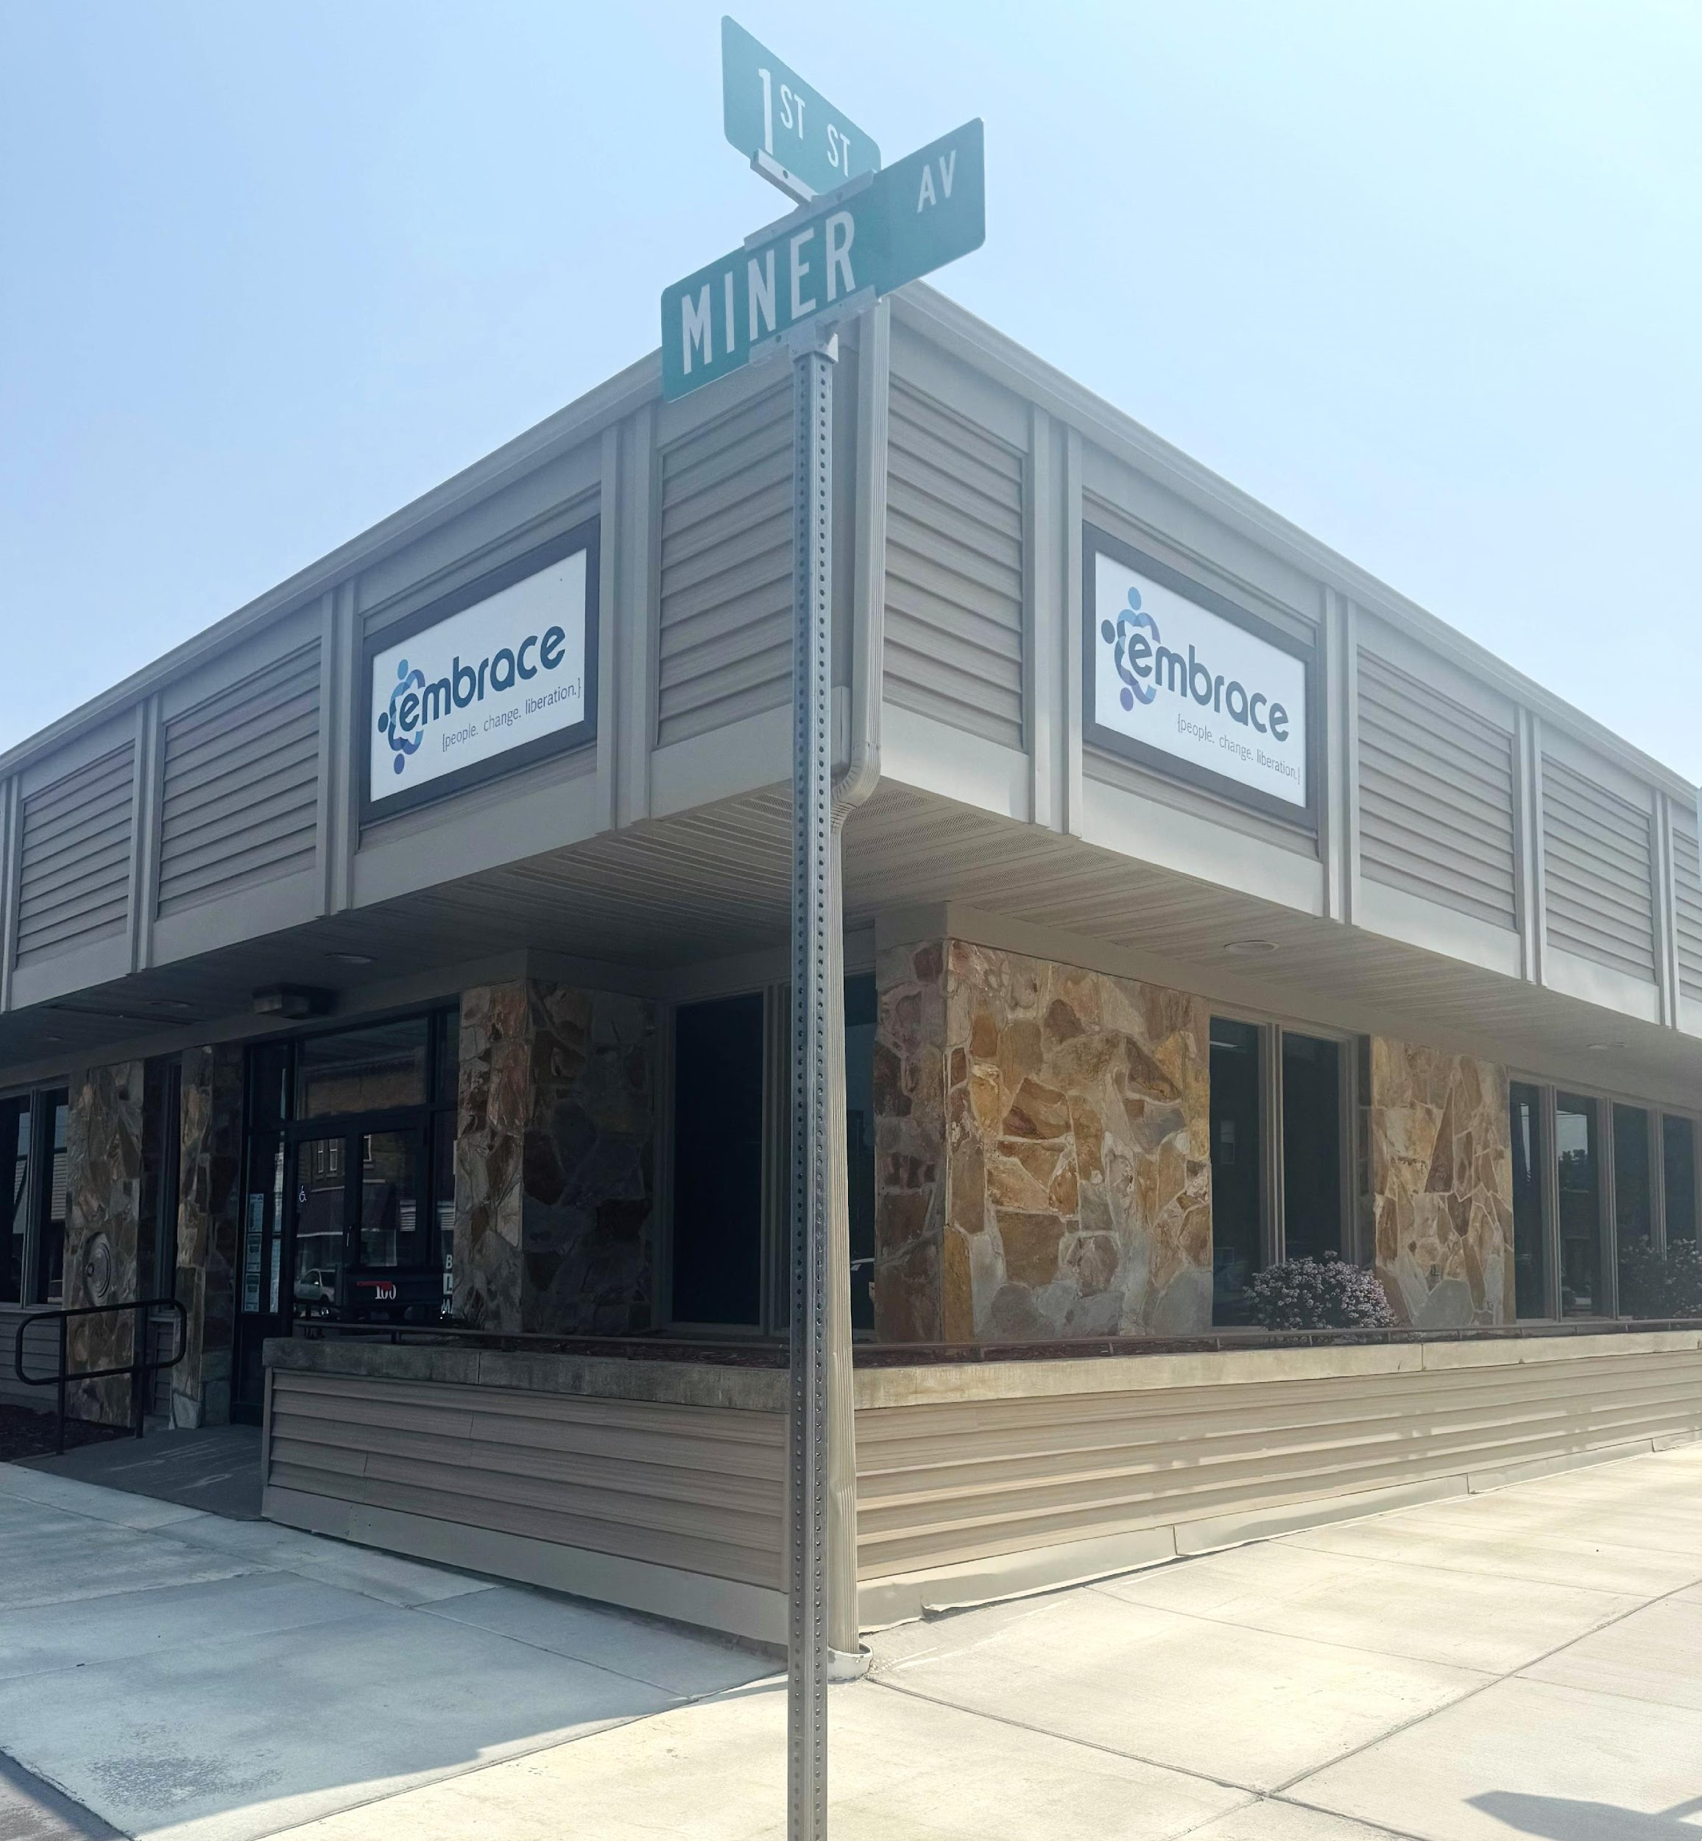
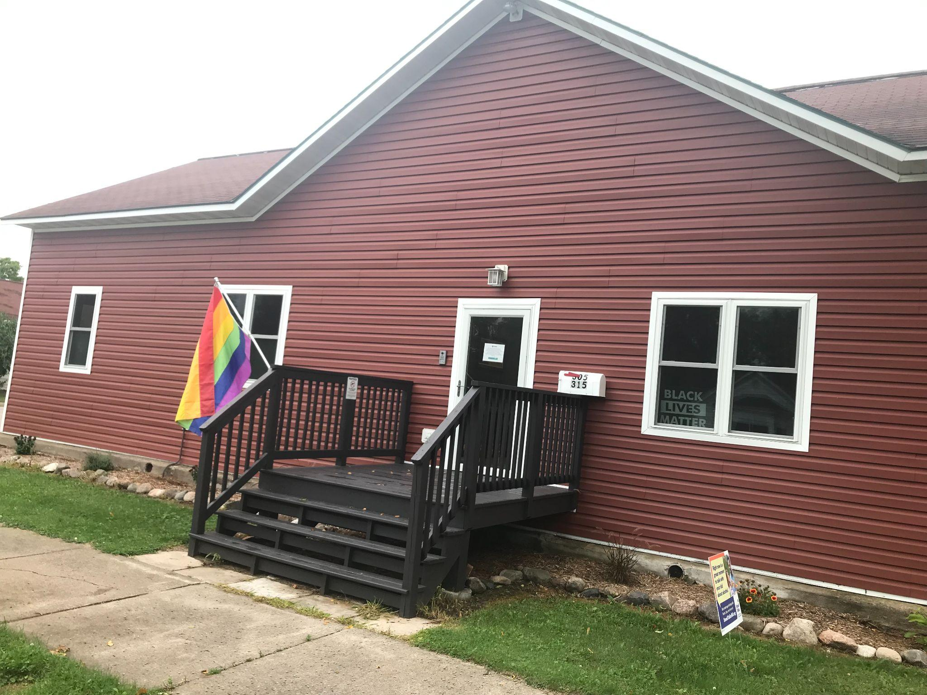
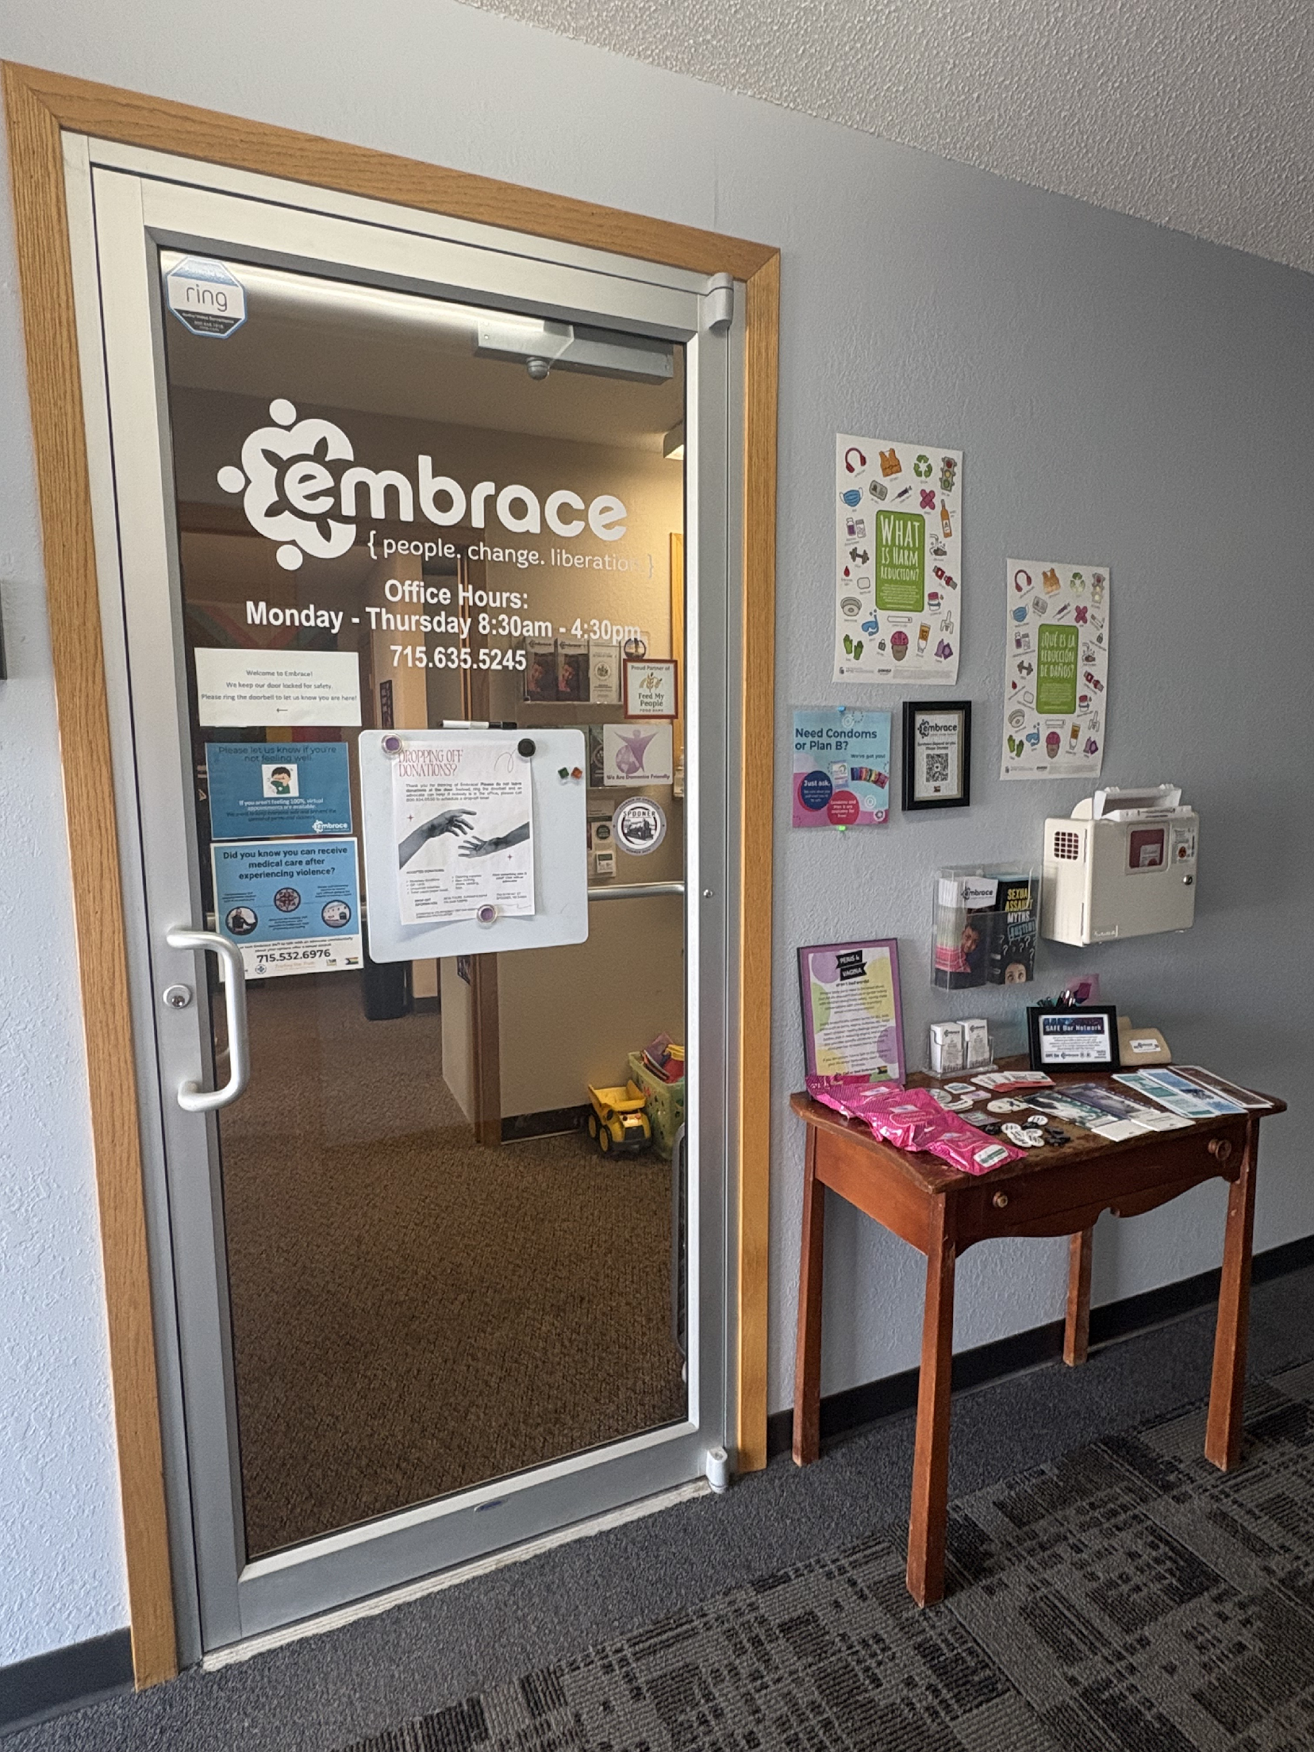
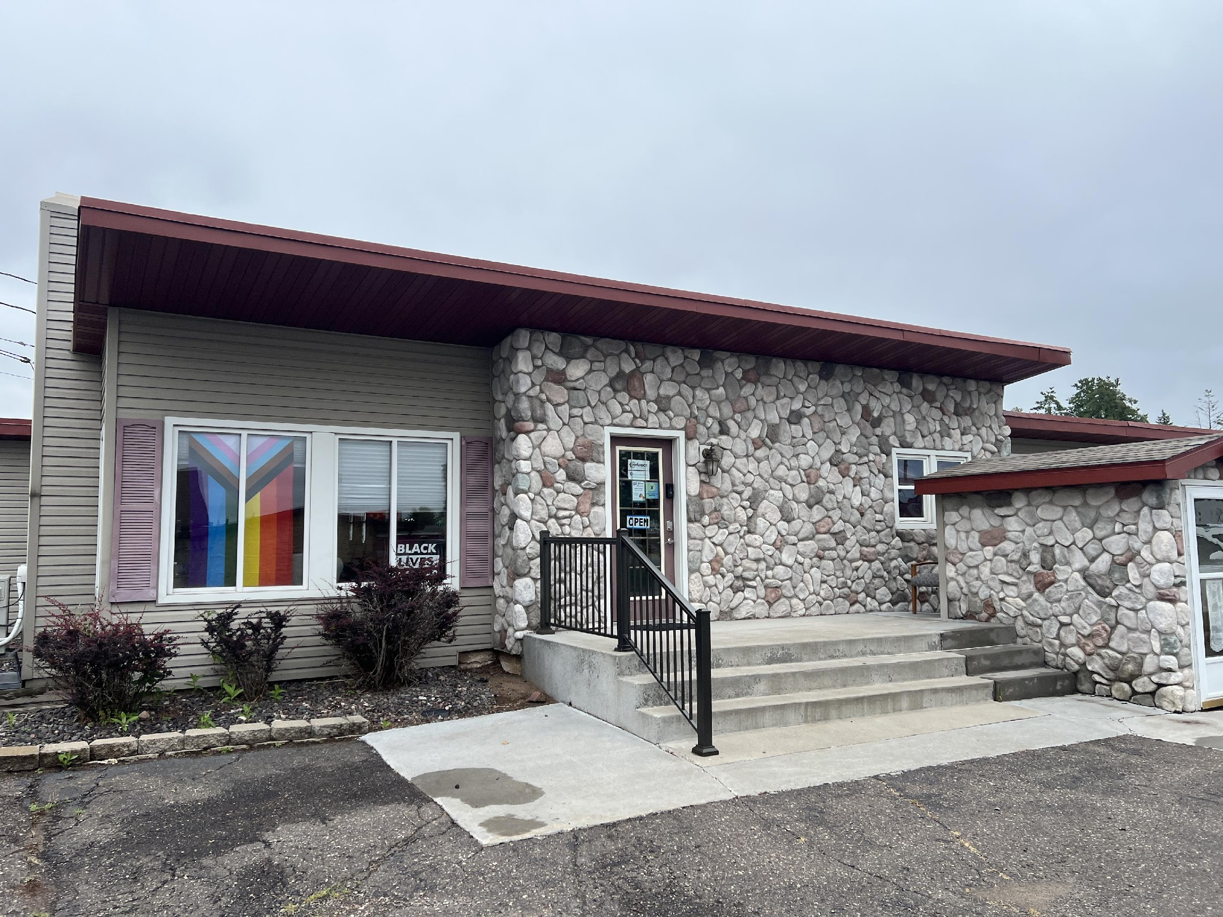
What is Embrace?
Embrace is a non-profit agency that provides free and confidential help to anyone impacted by gender-based violence, including domestic and sexual violence. For over the last 45 years, Embrace has provided safe shelter and support services to survivors in the four-county service area of Rusk, Washburn, Barron, and Price Counties.
Rusk County Office
Price County Office
Barron County Office
Washburn County Office

Slide 4
What Do Services Look Like?
Direct Services
Crisis Counseling
Info/Referrals
Personal Advocacy
Accompaniment
Housing Advocacy
Outreach and Prevention
School Presentations
Media Events
Awareness Displays
Systems Advocacy
Partnerships
Collaborative Meetings
Community Trainings
Harm Reduction
24/7 Harm Reduction Vending Machines in Price & Rusk County!

Slide 5
Connection Between Substance Use and Domestic & Sexual Violence
60% of Intimate Partner Violence (IPV) incidents have a co-occurring factor in common: substance use.
Substance use in women who have experience IPV has been reported as a means of coping with the physical and emotional pain survivors are experiencing.
The physical and sexual trauma that often occurs in Intimate Partner Violence (IPV) increases the risk for bodily injuries that can result in chronic pain, as well as head, neck, and/or facial injuries that can cause traumatic brain injury (TBI).

Slide 6
Impacts on Mental Health
IPV, substance use, and mental health conditions tend to coexist
Higher levels of physical and emotional IPV were related to an increased risk of Post Traumatic Stress Disorder, or PTSD, and higher levels of PTSD were related to higher risk of drug-related problems.
Turning to using substances as a form of coping
Harm-doers may weaponize these feelings and use them against survivor to maintain power and control

Slide 7
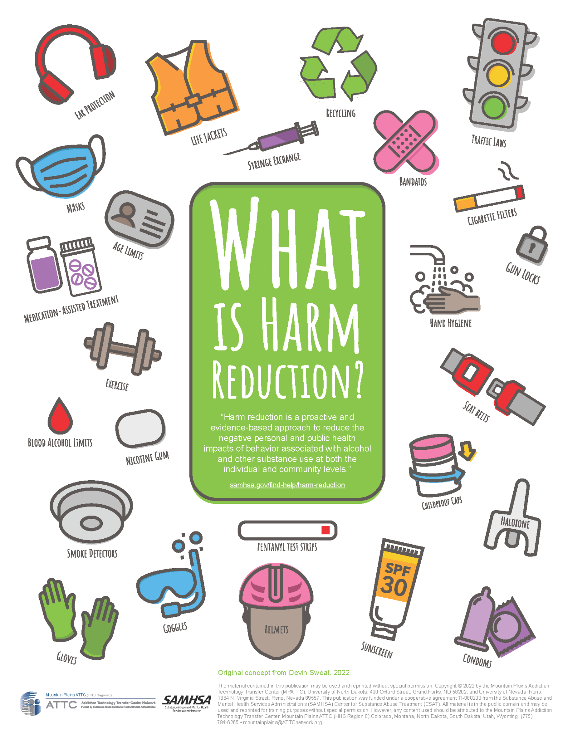
Harm Reduction Services
In northern, rural Wisconsin, substance use is prevalent, and Embrace provides harm reduction services which align with our vision of courageous social change ending all forms of oppression and violence.
Narcan
Safe Syringe Exchange
Seeking Safety curriculum
Emergency Contraceptives
Abortion resources

Slide 8
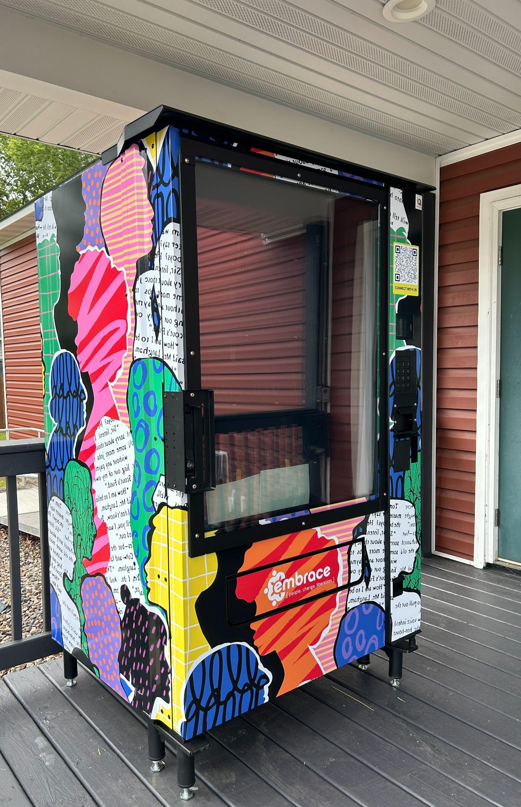
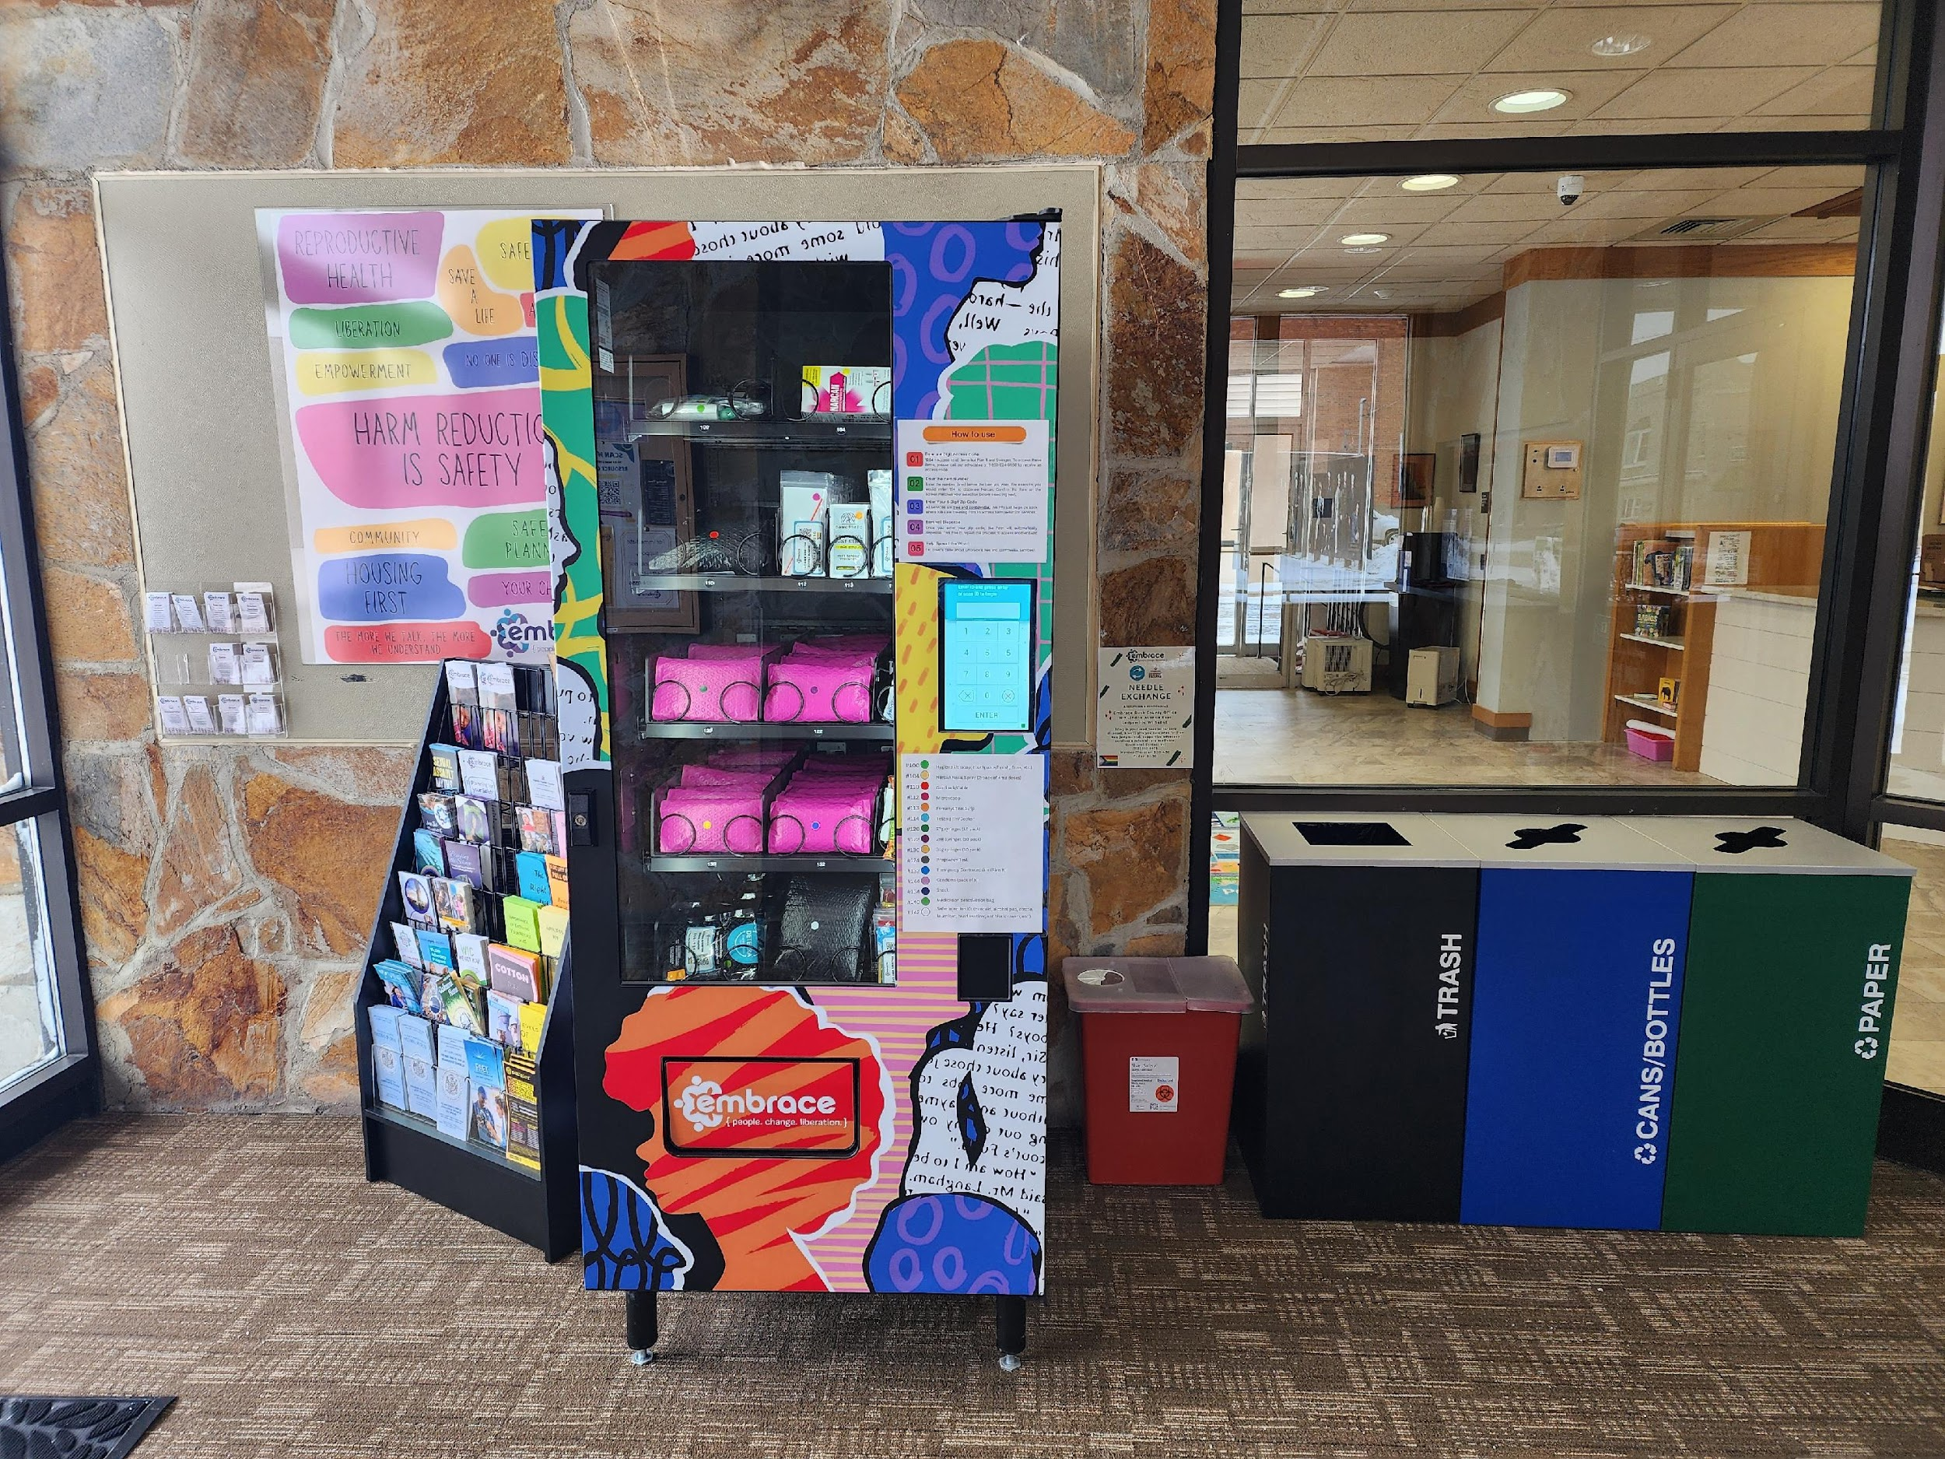
24/7 Harm Reduction Vending Machines
24/7 Harm Reduction Vending Machines
Available at the Rusk & Price County Offices (Ladysmith and Phillips)
Supplies included: syringes, fentanyl test-strips, Narcan, safer injection kits, Emergency Contraceptives, condoms, pregnancy tests, etc.
Walk-In Options
Available in all county offices during business hours - same supplies offered
Price County Office
Rusk County Office

Slide 9

Community Pushback, Stigmas, Misconceptions
Syringe Access Concerns
Safe Disposal Box Location
Misconceptions Around Harm Reduction
Narcan Stigma
Substance Use Stigma
Emergency Contraception Confusion

Slide 10
How We Approach Community Resistance
Starting small conversations about harm reduction
Prioritizing outreach to break down the stigmas and misconceptions
Giving presentations to local organizations and members in the community
Attending community events
Conversations with survivors and those accessing harm reduction resources
Educating and informing all options
Safety planning

Slide 11
Successes Thus Far
June & July Harm Reduction Statistics
Amount of people who accessed resources
65
Supplies distributed
1,508 Syringes
10 Narcan
25 Fentanyl Test Strips
19 Safe Use Kits
Partnerships
DHHS
Public Health
AODA
Vivent Health
Hope Consortium
Sister Agencies
Community Members

Slide 12



Thank you & Questions
24/7 Helpline: 800.924.0556
Website: embracewi.org
Jordanne Myszka-Schilling (she/they):
jordanne@embracewi.org

Slide 13
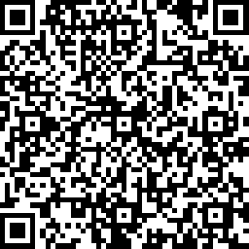
We would appreciate your time to complete this brief survey so we can continue to provide services to survivors!
https://www.surveymonkey.com/r/EmbraceOutreachPresentation

